Slide 1
Innovative Fluid Mechanics Technologies
CO₂ Compressor & System Technology:
Sustainable Heating & Cooling
September 2010
Notes:
Welcome

Slide 2
ATMOsphere 2010
Shared Mission
Promote natural refrigerants
Reduce energy consumption & GHG
Shorten time to market
Accelerate market adoption
EcoThermics Solution
Natural refrigerant compressor
Significantly improves performance of heat pumps
Environmentally sustainable
Notes:
All of us here at ATMOsphere 2010 share a common goal – hastening adoption of natural refrigerants globally
We are here because we not only care about environmental sustainability, (significant reduction in energy consumption and climate change) but we are taking action!
How do we eliminate barriers and expedite the transition to natural refrigerants?
The first step, we believe, is the availability of viable alternatives (compressors, components and the like)
In addition to being environmentally sustainable, our compressor will significantly improve the energy efficiency and performance of heat pumps

Slide 3
Overview
Speed to Market - 7 Key Elements:
Proven technology & integrated system solutions
Critical alliances and partnerships
Highly leveraged supply chain
Unquestionably convincing value proposition
Market ripe for new paradigms
Supportive governmental policies and practices
Education of distribution channel and end users
Notes:
We have identified 7 critical success factors to expediting market adoption of natural refrigerant technologies
We will discuss progress EcoThermics has made in development of CO2 compressor technology
We will share with you how we are leveraging partners, suppliers, industry experts and so forth to move more quickly
We will summarize our value proposition
Finally, we will have an open, interactive discussion about the what will be required from a communications and regulatory standpoint to prompt change

Slide 4
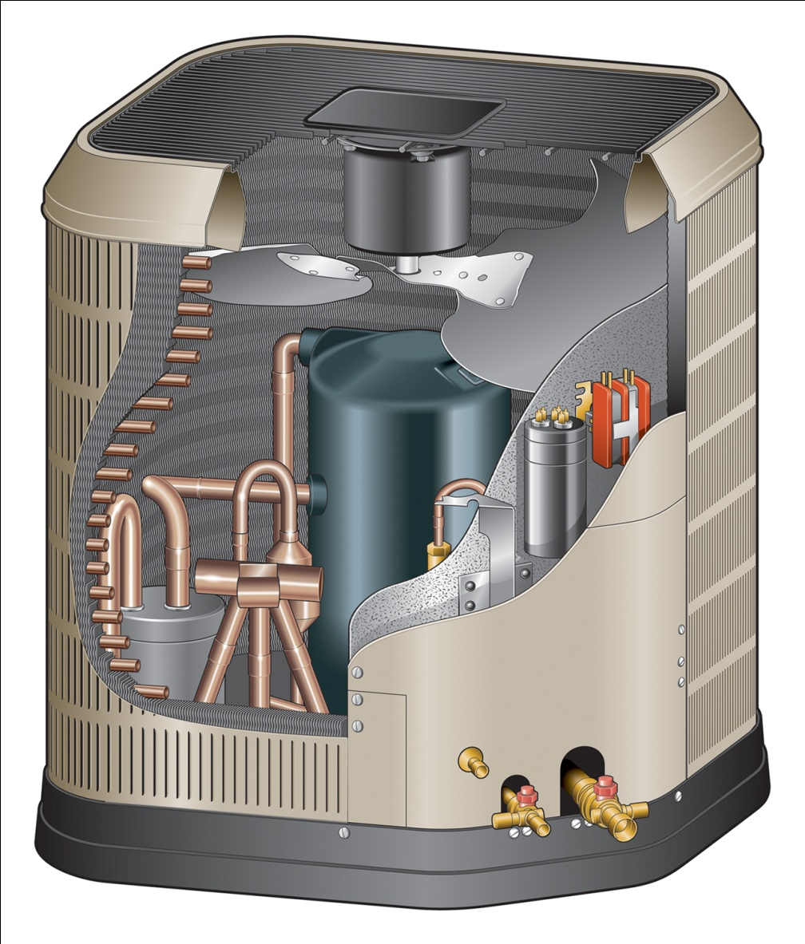
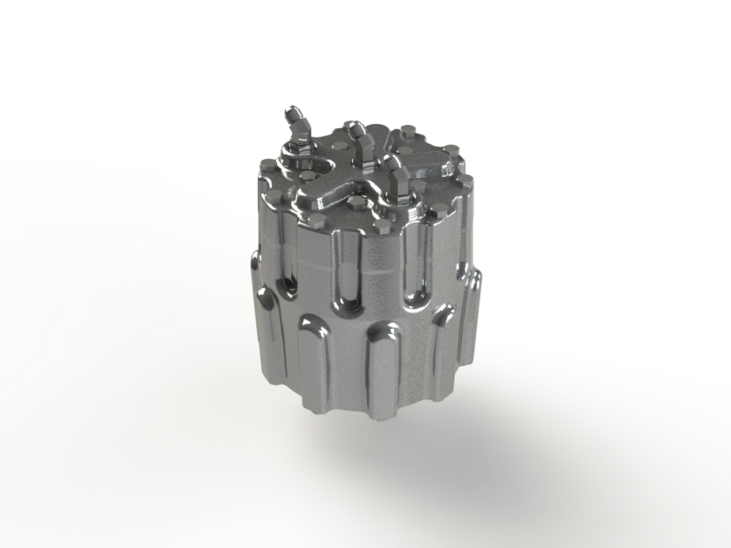
EcoThermics CO₂ Compressor
Manufacturing * compressor solutions for
next generation
heat pumps
* via contract mfg. partner
“EcoThermics Inside”
Notes:
So who are we?
EcoThermics Corp., headquartered in the Midwestern U.S. was founded in 2007 to commercialize this innovative CO2 compressor technology
Originally developed for and partially funded by the U.S. Army 8 years ago…
Our robust, high-performance compressor is an enabling component that OEM’s will use to build sustainable and economically responsible HVAC systems.

Slide 5
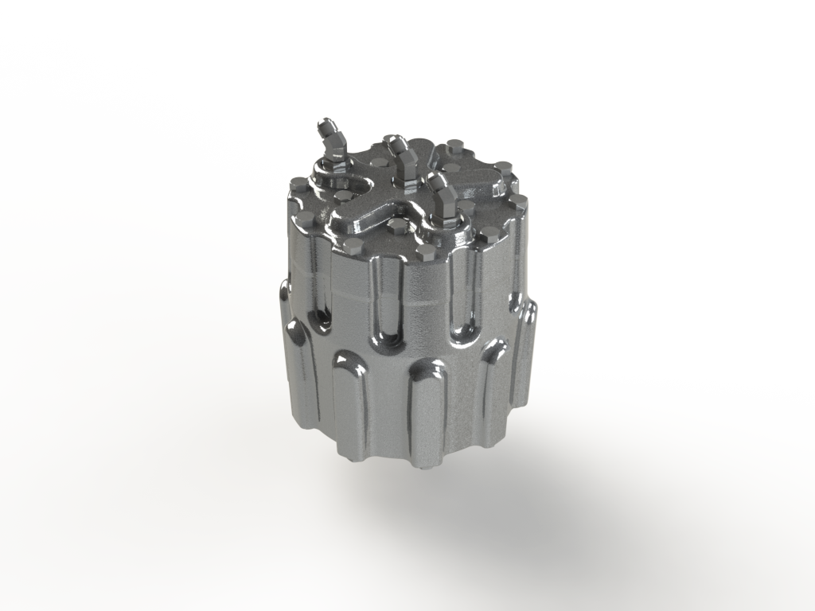
Proven Technology
EcoThermics AT54 Compressor
Superior axial CO₂ compressor
Compact; high power density
Cost driven core design
Competitive performance
Right size for commercial HW heating
OEM application flexibility
- scalable - modular
- configurable - manufacturable
Notes:
EcoThermics axial compressor design is compact with high power density.
Our novel design for ease of manufacturability will make this unit highly cost competitive
With over 2000 hours of lab testing, both at our world-class test facility in Ohio and world-renowned Herrick Labs at Purdue University, durability and performance results make our compressor competitive with all others in it’s size class. Once optimized for performance and cost, we expect our unit to be the best value available.
Future OEM customers will be attracted to the unique application flexibility of this compressor

Slide 6
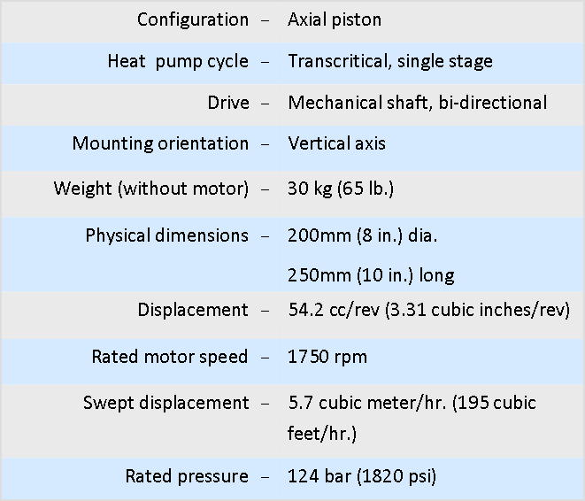
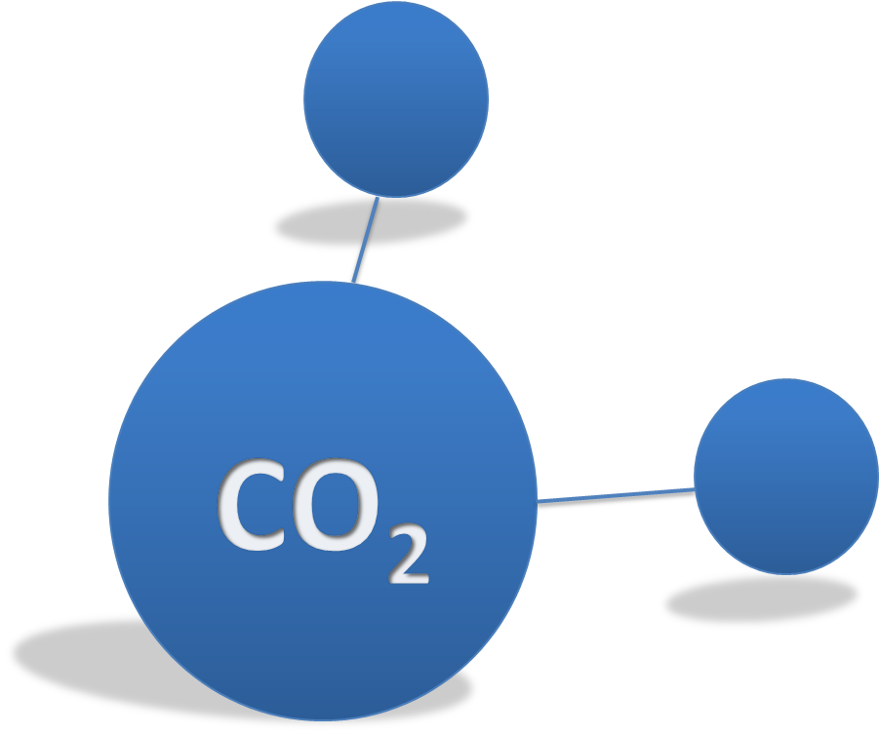
AT54 Product Specs
Performance Forecast

Slide 7
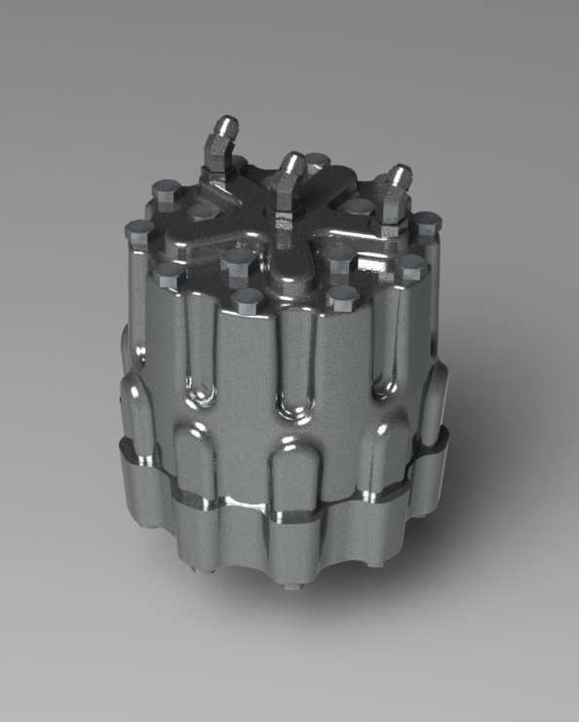
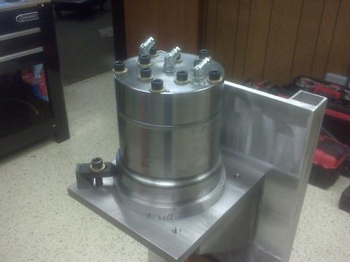
Product Evolution
AT54 (2011)
MK-3 (2010)
MK-2 (2009)
Compressor
MK-1 (2008)
Notes:
Where we have moved our compressor through various stages of development
We are now finalizing design of our 6th generation prototype, the AT54M
EcoThermics has a proven history of successful product development and testing…with continuous improvements in durability, performance and cost

Slide 8
Development Status
Extensive testing in three lab test facilities; competitive performance targets achieved
Field testing underway in two locations
Limited quantities of compressors available now to select OEM’s for system design and testing
On target for pilot production (2Q 2011)
Prototype goals achieved
On target for pilot phase
Notes:
As far as our current state of product development:
Testing at Purdue confirms durability and efficiency. We have met performance goals and are on target for pilot phase production to start 2Q 2011, manufactured and assembled by contract manufacturing partner Mennie Machine Co
Field test projects are beginning in upcoming months at Indiana Tech University and StollPak, a honey-processing plant in Ohio
We have identified our initial target market: commercial hot water heaters and have limited quantities of compressors available to select OEMs for system design and testing

Slide 9
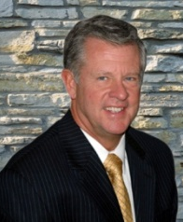
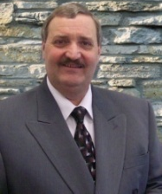
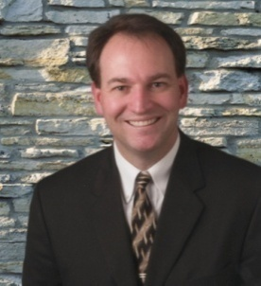
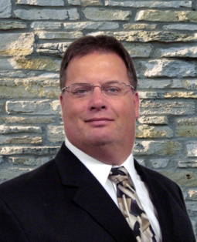
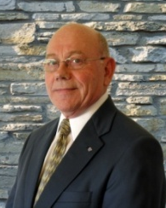
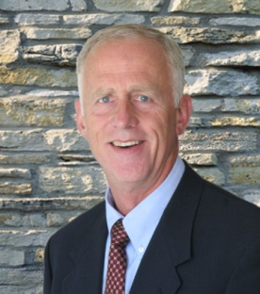
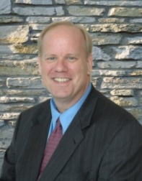
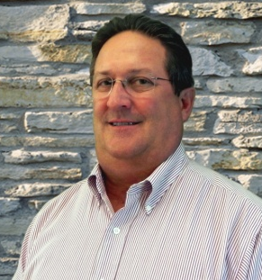
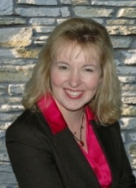
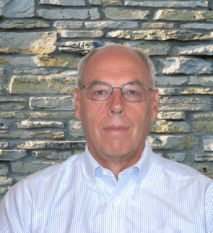
Merle Rocke
Chairman & CEO
Founder & former GM, Caterpillar Logistics
Manufacturing, technology, supply chain
Marc Albertin
Director of Innovation
Founder, inventor, applications engineer
Prototype development and fabrication
Travis Horton, PhD
Chief Technology Officer
Expert in transcritical CO₂ compression
Purdue University faculty
Daniel Sherman
Director of Engineering
Design engineering, system integration
Electronic/hydraulic system design expertise
Rodney Hugelman, PhD
Chief Scientist
Rocket engine, Mars, Atlas Missile projects
Professor Emeritus, University of Illinois
Craig Riediger
Product Consultant
Strategic product development, Caterpillar
Component development; holds 12 patents
Thomas Lewicki
Chief Financial Officer
Commercialization (MS Internet Explorer)
IPO’s, strategic investments, spin-outs
Al Sabin
Manufacturing Consultant
High velocity manufacturing champion
Est. Caterpillar engine business in China
Tammie Leichtenberg
Director of Corporate Services
Marketing, communications, administration
Strategic analysis & business development
Tom Dennison
Product Consultant
Component & complex system development
New product intro & machine validation
Notes:
One of the keys elements of successful product development is having the right team in place.
I have led numerous start-up ventures in addition to a 35 year career with Caterpillar
Our CFO was involved in commercialization of what eventually become known to the world as MS Internet Explorer and works in close communication with our Director of Marketing
Together with the management team, our two brilliant PhD’s with backgrounds in high pressure hydraulics, CO2 and thermodynamics lead an extraordinary team of engineers, and product and manufacturing experts

Slide 10
Building Value
Notes:
“Our primary goal is to build VALUE and we WILL succeed by staying focused on that goal, moving with speed and clarity and by leveraging the relationships necessary to make that happen.”

Slide 11
Leverage Partners & Supply Chain
Speed to Market - 7 Key Elements:
Proven technology & integrated system solutions
Critical alliances and partnerships
Highly leveraged supply chain
Unquestionably convincing value proposition
Market ripe for new paradigms
Supportive governmental policies and practices
Education of distribution channel and end user
Notes:
Which leads us to our next two critical success factors, alliances and partnerships and a highly leveraged supply chain.

Slide 12
Leveraging Partnerships
…to enhance speed, precision and value
WaterFurance Renewable Energy - system integration
Festec Automation - prototype development
Mennie Machine Company - production manufacturing
Shecco - market research
Purdue University - lab testing
Indiana Tech & StollPak Inc. - field testing
Subject Matter Experts - design,
production & manufacturing expertise
Notes:
In addition to the above, we are searching for individuals and companies who share our vision and passion, interested in partnering with us in some form to accomplish two things:
Promoting CO2 faster to market and
Enabling EcoThermics to move faster to market
Through leveraging partnerships, our small company works harder and smarter to do more with less… building value day after day

Slide 13
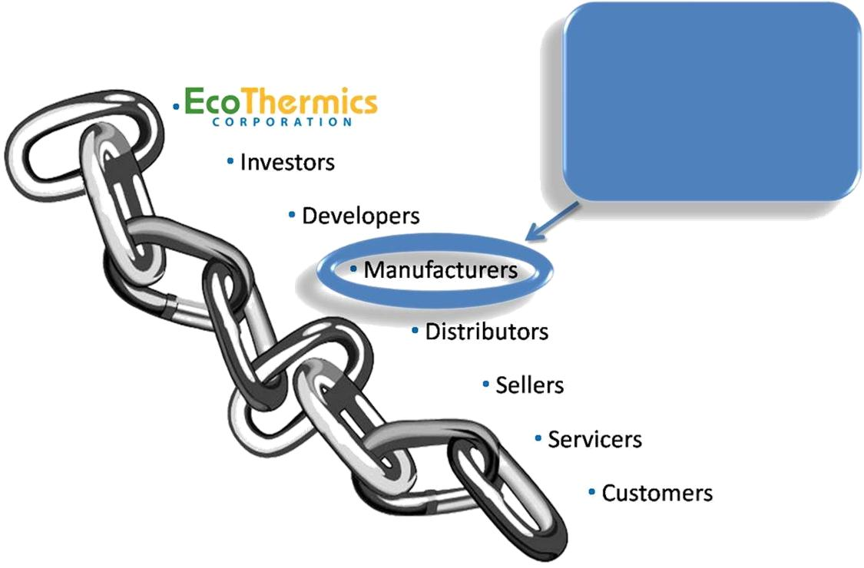
Leveraging Supply Chain
EcoThermics enters supply chain here
EcoThermics enters supply chain here
Notes:
Objectives: Speed to market and speed to scale
Methodology: Leverage and collaboration with each component of the value chain.

Slide 14
Value Proposition
Speed to Market - 7 Key Elements:
Proven technology & integrated system solutions
Critical alliances and partnerships
Highly leveraged supply chain
Unquestionably convincing value proposition
Market ripe for new paradigms
Supportive governmental policies and practices
Education of distribution channel and end user
Notes:
So let’s talk a little bit about our value proposition to our partners, investors, and customers

Slide 15
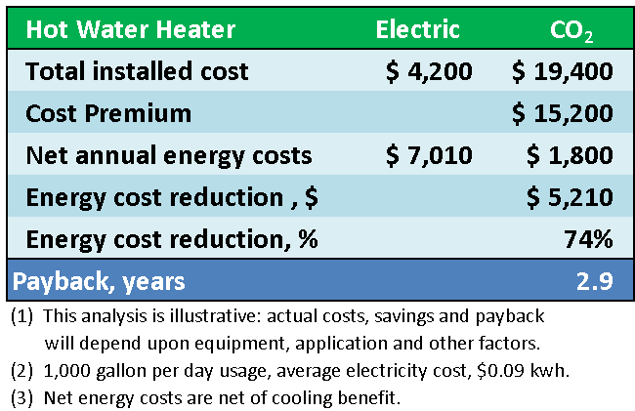
End User Payback Analysis
Notes:
TO PUT EFFICIENCY DATA IN TERMS OF FINANCIAL PAYBACK – CO2 SYSTEMS PROVIDE AN ATTRACTIVE RETURN ON INVESTMENT
40% of commercial water heaters are electric
To put data into a payback perspective, we developed this analysis for a commercial laundry in Connecticut.
Based upon our estimates of installed cost for these 4 systems, financial payback periods are extremely attractive compared to electric and propane systems, and still good compared to natural gas equipment.
Keep in mind that the life of these systems is >20 years.
In Europe, where electric rates are even higher than the U.S. average, our value proposition is even stronger
Savings are greater as hot water consumption increases. This is one reason we have targeted high demand applications in commercial water heating.

Slide 16
The Market
Speed to Market - 7 Key Elements:
Proven technology & integrated system solutions
Critical alliances and partnerships
Highly leveraged supply chain
Unquestionably convincing value proposition
Market ripe for new paradigms
Supportive governmental policies and practices
Education of distribution channel and end user
Notes:
So what makes a market ripe for new paradigms?

Slide 17
Market Drivers
Performance
& efficiency
High cost of energy - money & environmental impact
Global effort to reduce climate change
Increasing governmental involvement & regulation
Consumer demand for greener products
Availability of natural refrigerant components
Japan & Europe - encouraging examples
The U.S. remains a viable, new open market
Factors driving toward an eventual tipping point…

Slide 18
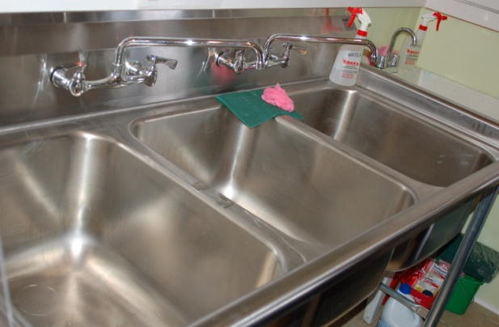
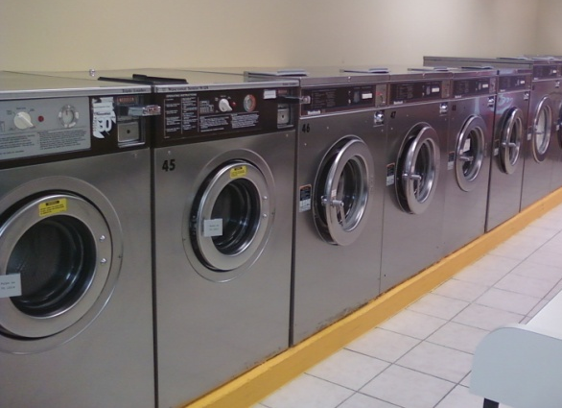
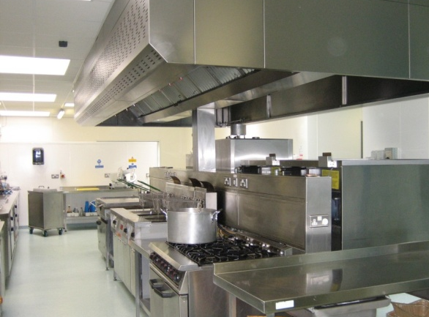
Entry Level Market Opportunity
Commercial heat pump water heater
Reduces energy cost up to 80%
Provides “free cooling” as well
Payback in 2-4 years
High heating temperatures
Wide range of ambient conditions
Precise zone temperature control
Easy to install and service
No GHG emissions
Notes:
Building upon the inherent higher temperature performance of CO2 heat pump systems, our initial market entry will be commercial heat pump water heaters.
Looking for European OEM partners to build systems
There is new market opportunity and growth in the U.S.

Slide 19
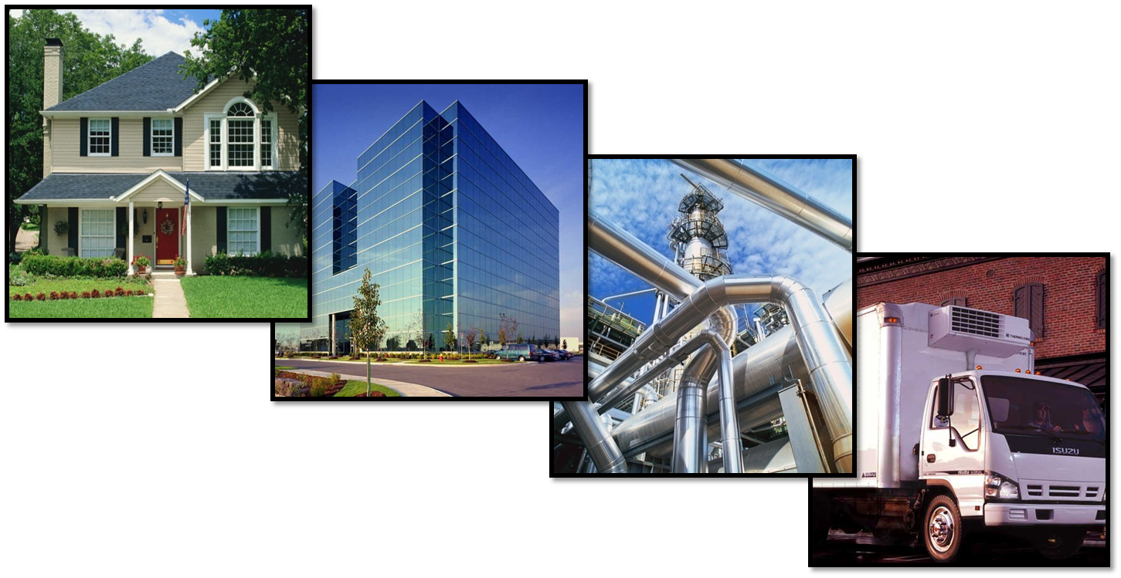
Broad Market Applications
Residential
Commercial
Industrial
Mobile/Portable
Notes:
With performance enhancements such as Energy Recovery and cost efficiencies from economies of scale, this technology will be ideal in a wide variety of applications…
Such as residential (new & retrofit), commercial, industrial, mobile or portable
Globally

Slide 20
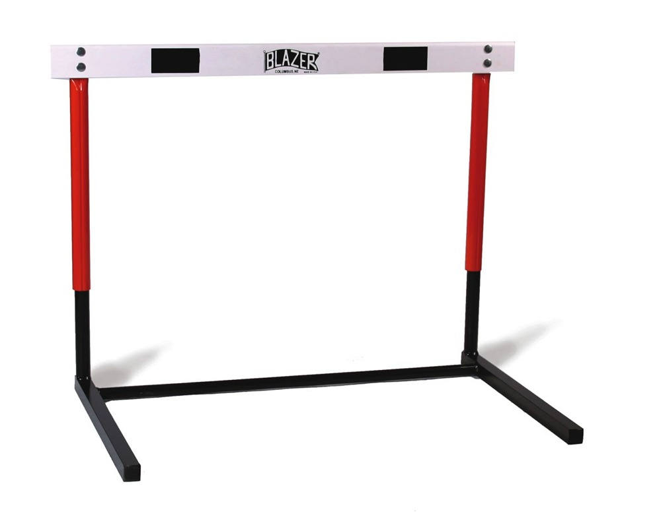
Barriers to Adoption
U.S. governmental legislation still several years behind Europe/Japan
New technology costs more initially
Lack of knowledge by customers and distribution channel
Inertia of current technologies & widespread resistance to change
CO₂ slightly less efficient at cooling
…simply hurdles to be overcome
Notes:
20

Slide 21
Prompting Change…
Speed to Market - 7 Key Elements:
Proven technology & integrated system solutions
Critical alliances and partnerships
Highly leveraged supply chain
Unquestionably convincing value proposition
Market ripe for new paradigms
Supportive governmental policies and practices
Education of distribution channel and end user

Slide 22
Action Opens Doors
Governmental interest & involvement
Incentives (tax credits)
Penalties – targeting applications using HFCs where alternatives are available
Fund R & D
Competitive pressures
Educate OEM system builders & end-users
Elicit support from industry thought leaders
Communications – spread the word
Profit motive
Demonstrate convincing value proposition - payback
Form alliances with partners willing to take early financial and market risk
Continued focus on superior durability, performance and lower cost of ownership
Notes:
22

Slide 23
Thank You
Contact us:
Merle G. Rocke, CEO
mrocke@ecothermics.com
309-303-0681
www.ecothermics.com

